Slide 1
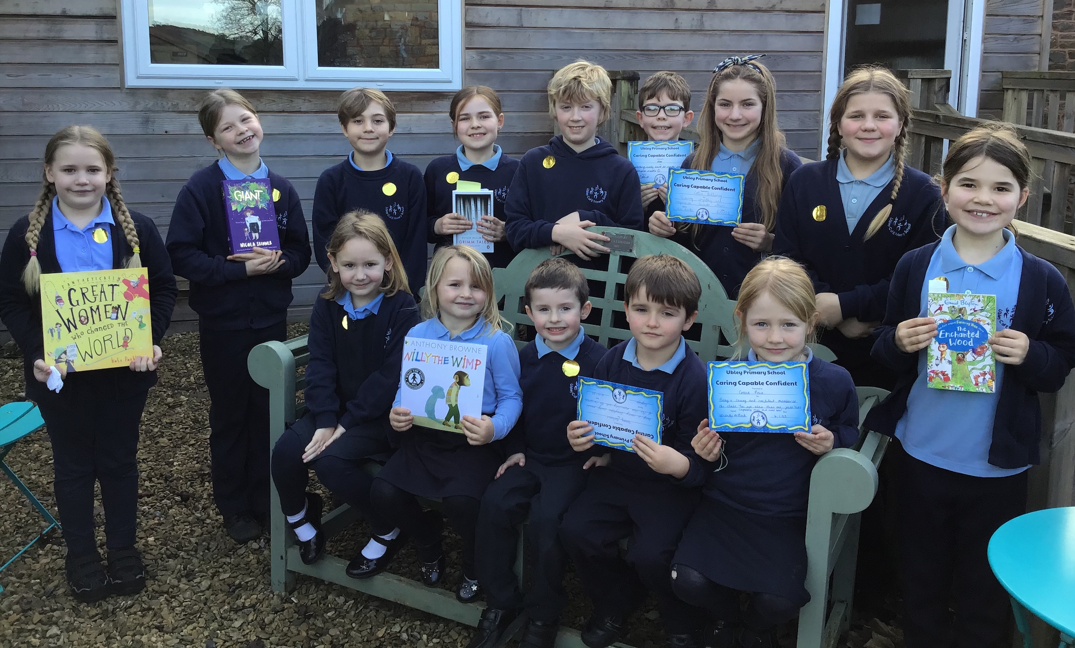
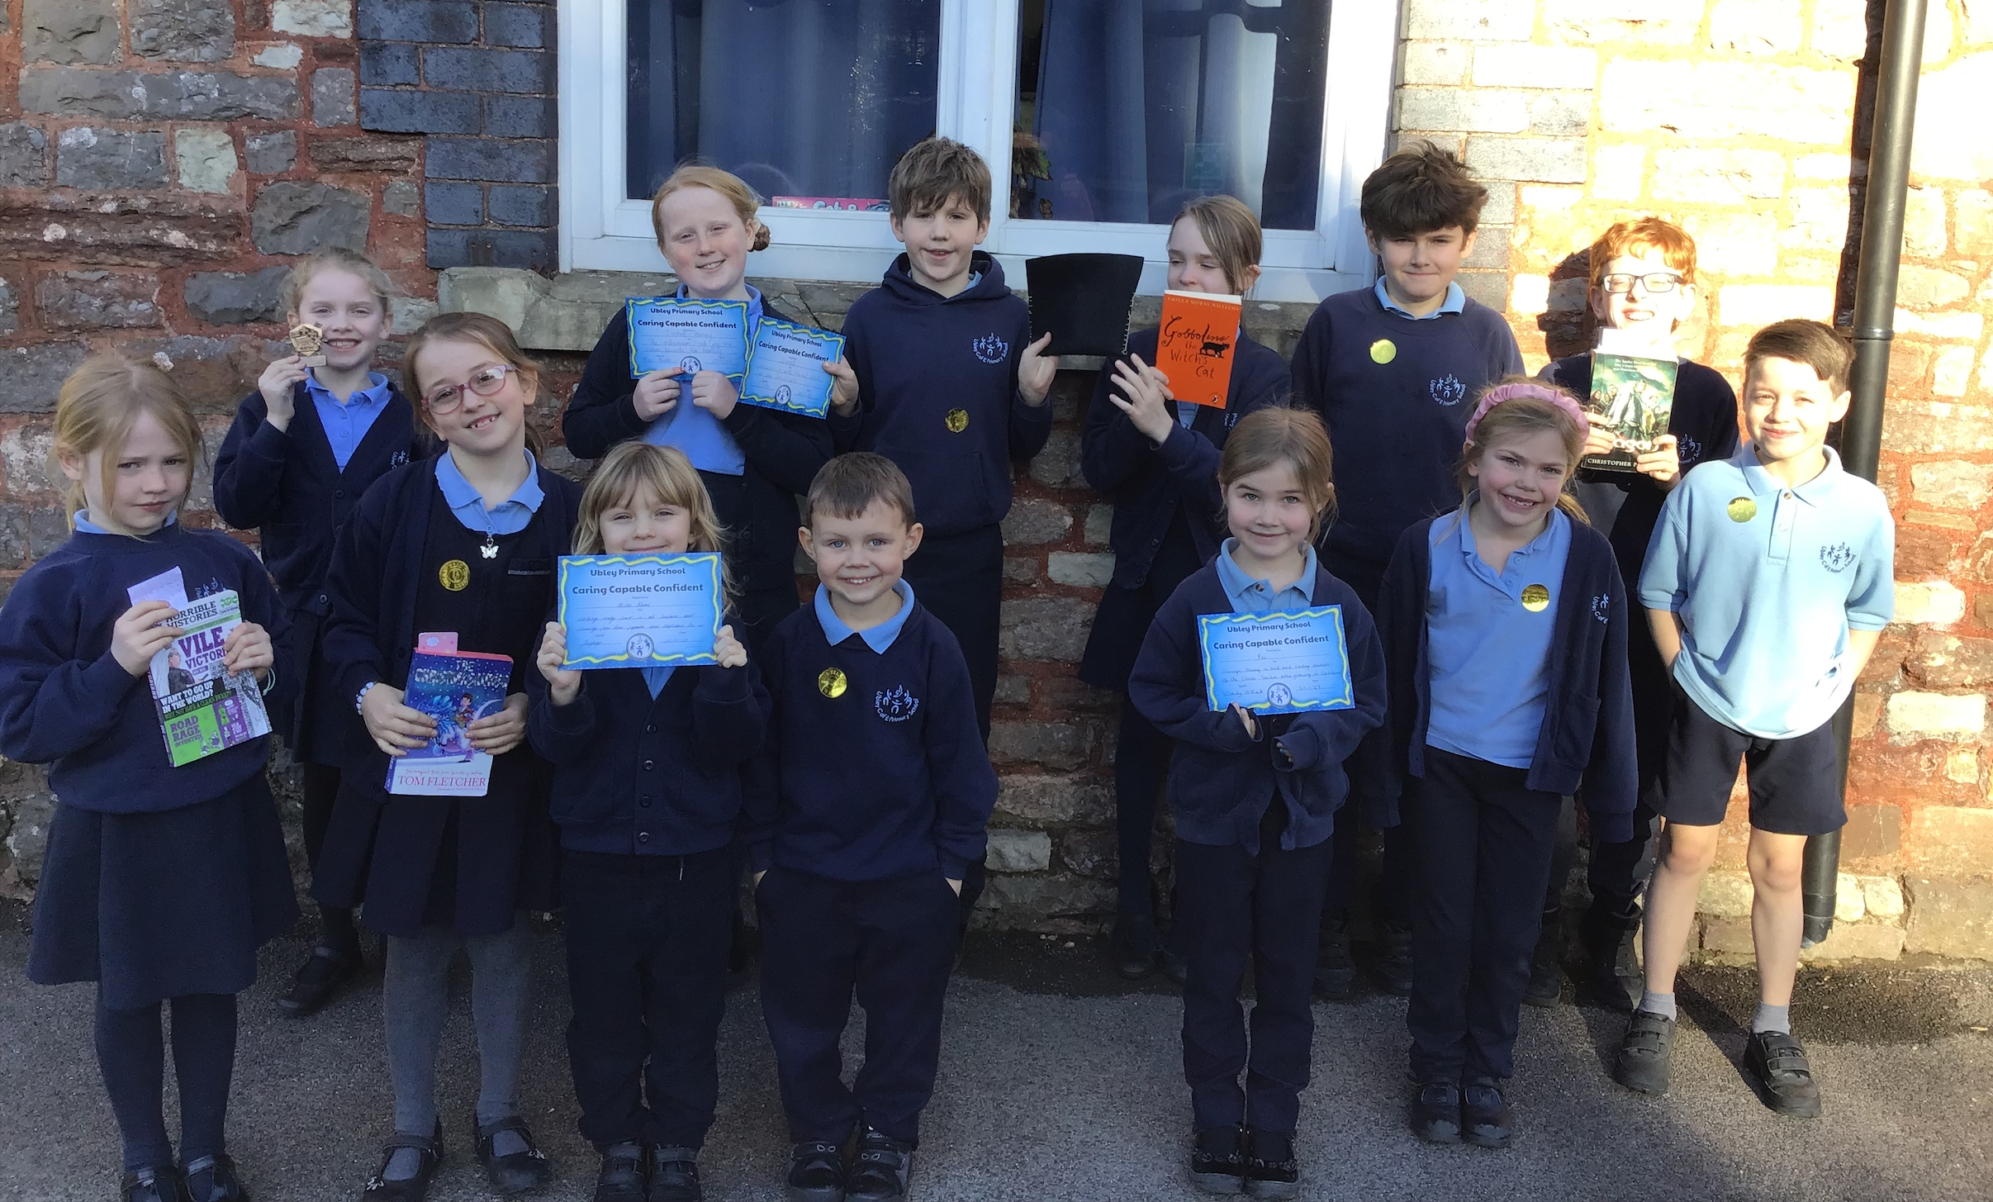
Ubley C of E Primary School Newsletter
27th January 2023
Celebration Assemblies
Congratulations to all the children who received certificates and awards during the first 2 weeks of term.
Certificates went to Tommy, Grace, Alex, Lottie, Alisa, Pru, Lionel and Isobel.
Reading award to Poppy, Willow, Esme, Abigail, Manon, Grace, Evelyn, Olivia and Nathan
Perseverance awards to Teddy, Wren, Jack KB, Cara, Dylan, Louie, Sadie, Lionel and Hector
Well done Mendip house for winning the house points in week 1 and week 2

Slide 2
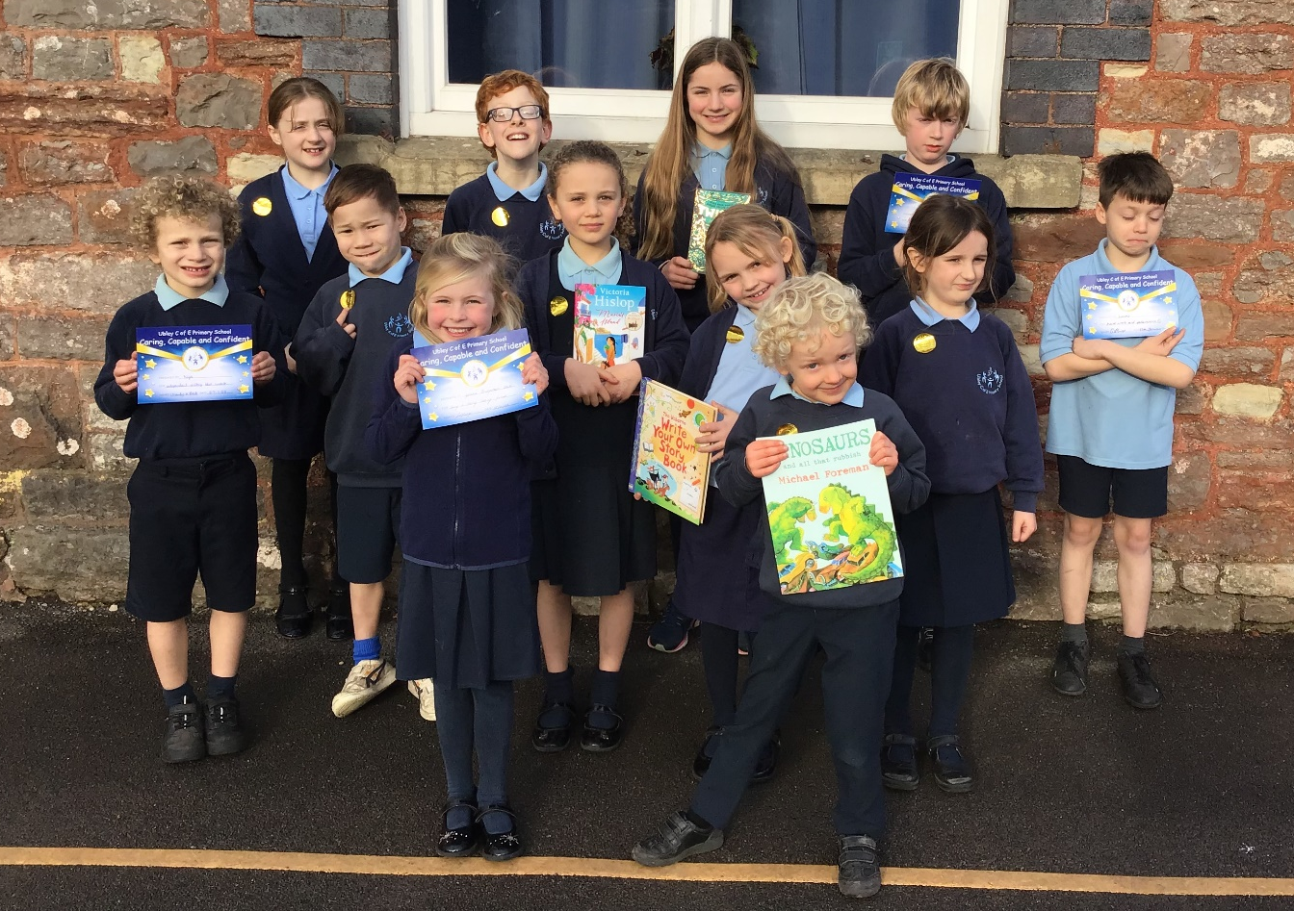
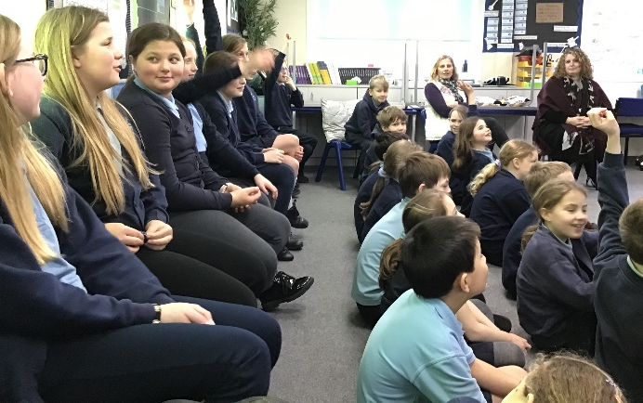
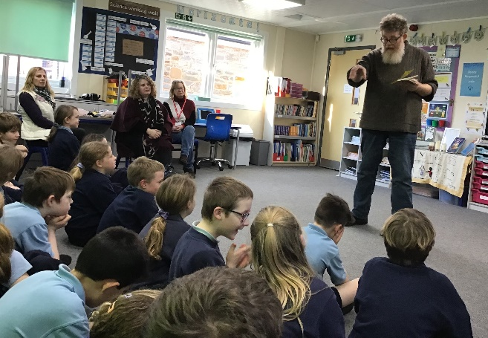
Celebration Assemblies
Congratulations to all the children who received certificates and awards this week.
Certificates went to Syvana, Nye, Lucas and Dylan.
Reading award to Oaklan, Trixie, Nell and Lottie
Perseverance awards to Bea M, Arthur, Ivy-Belle and Nathan
Well done Chew house for winning the house point award this week
Visit from Poet A.F. Harrold
On Tuesday the 24th January we welcomed the poet A.F.Harrold to our school.
‘He was really funny, and read his poems in a fun way with lots of actions. He had a big beard and had written a poem about what you can find in your beard’
Cara
‘His poems had lots of jokes in them and he let us say what we thought was going to happen in the poem.
Nathan

Slide 3
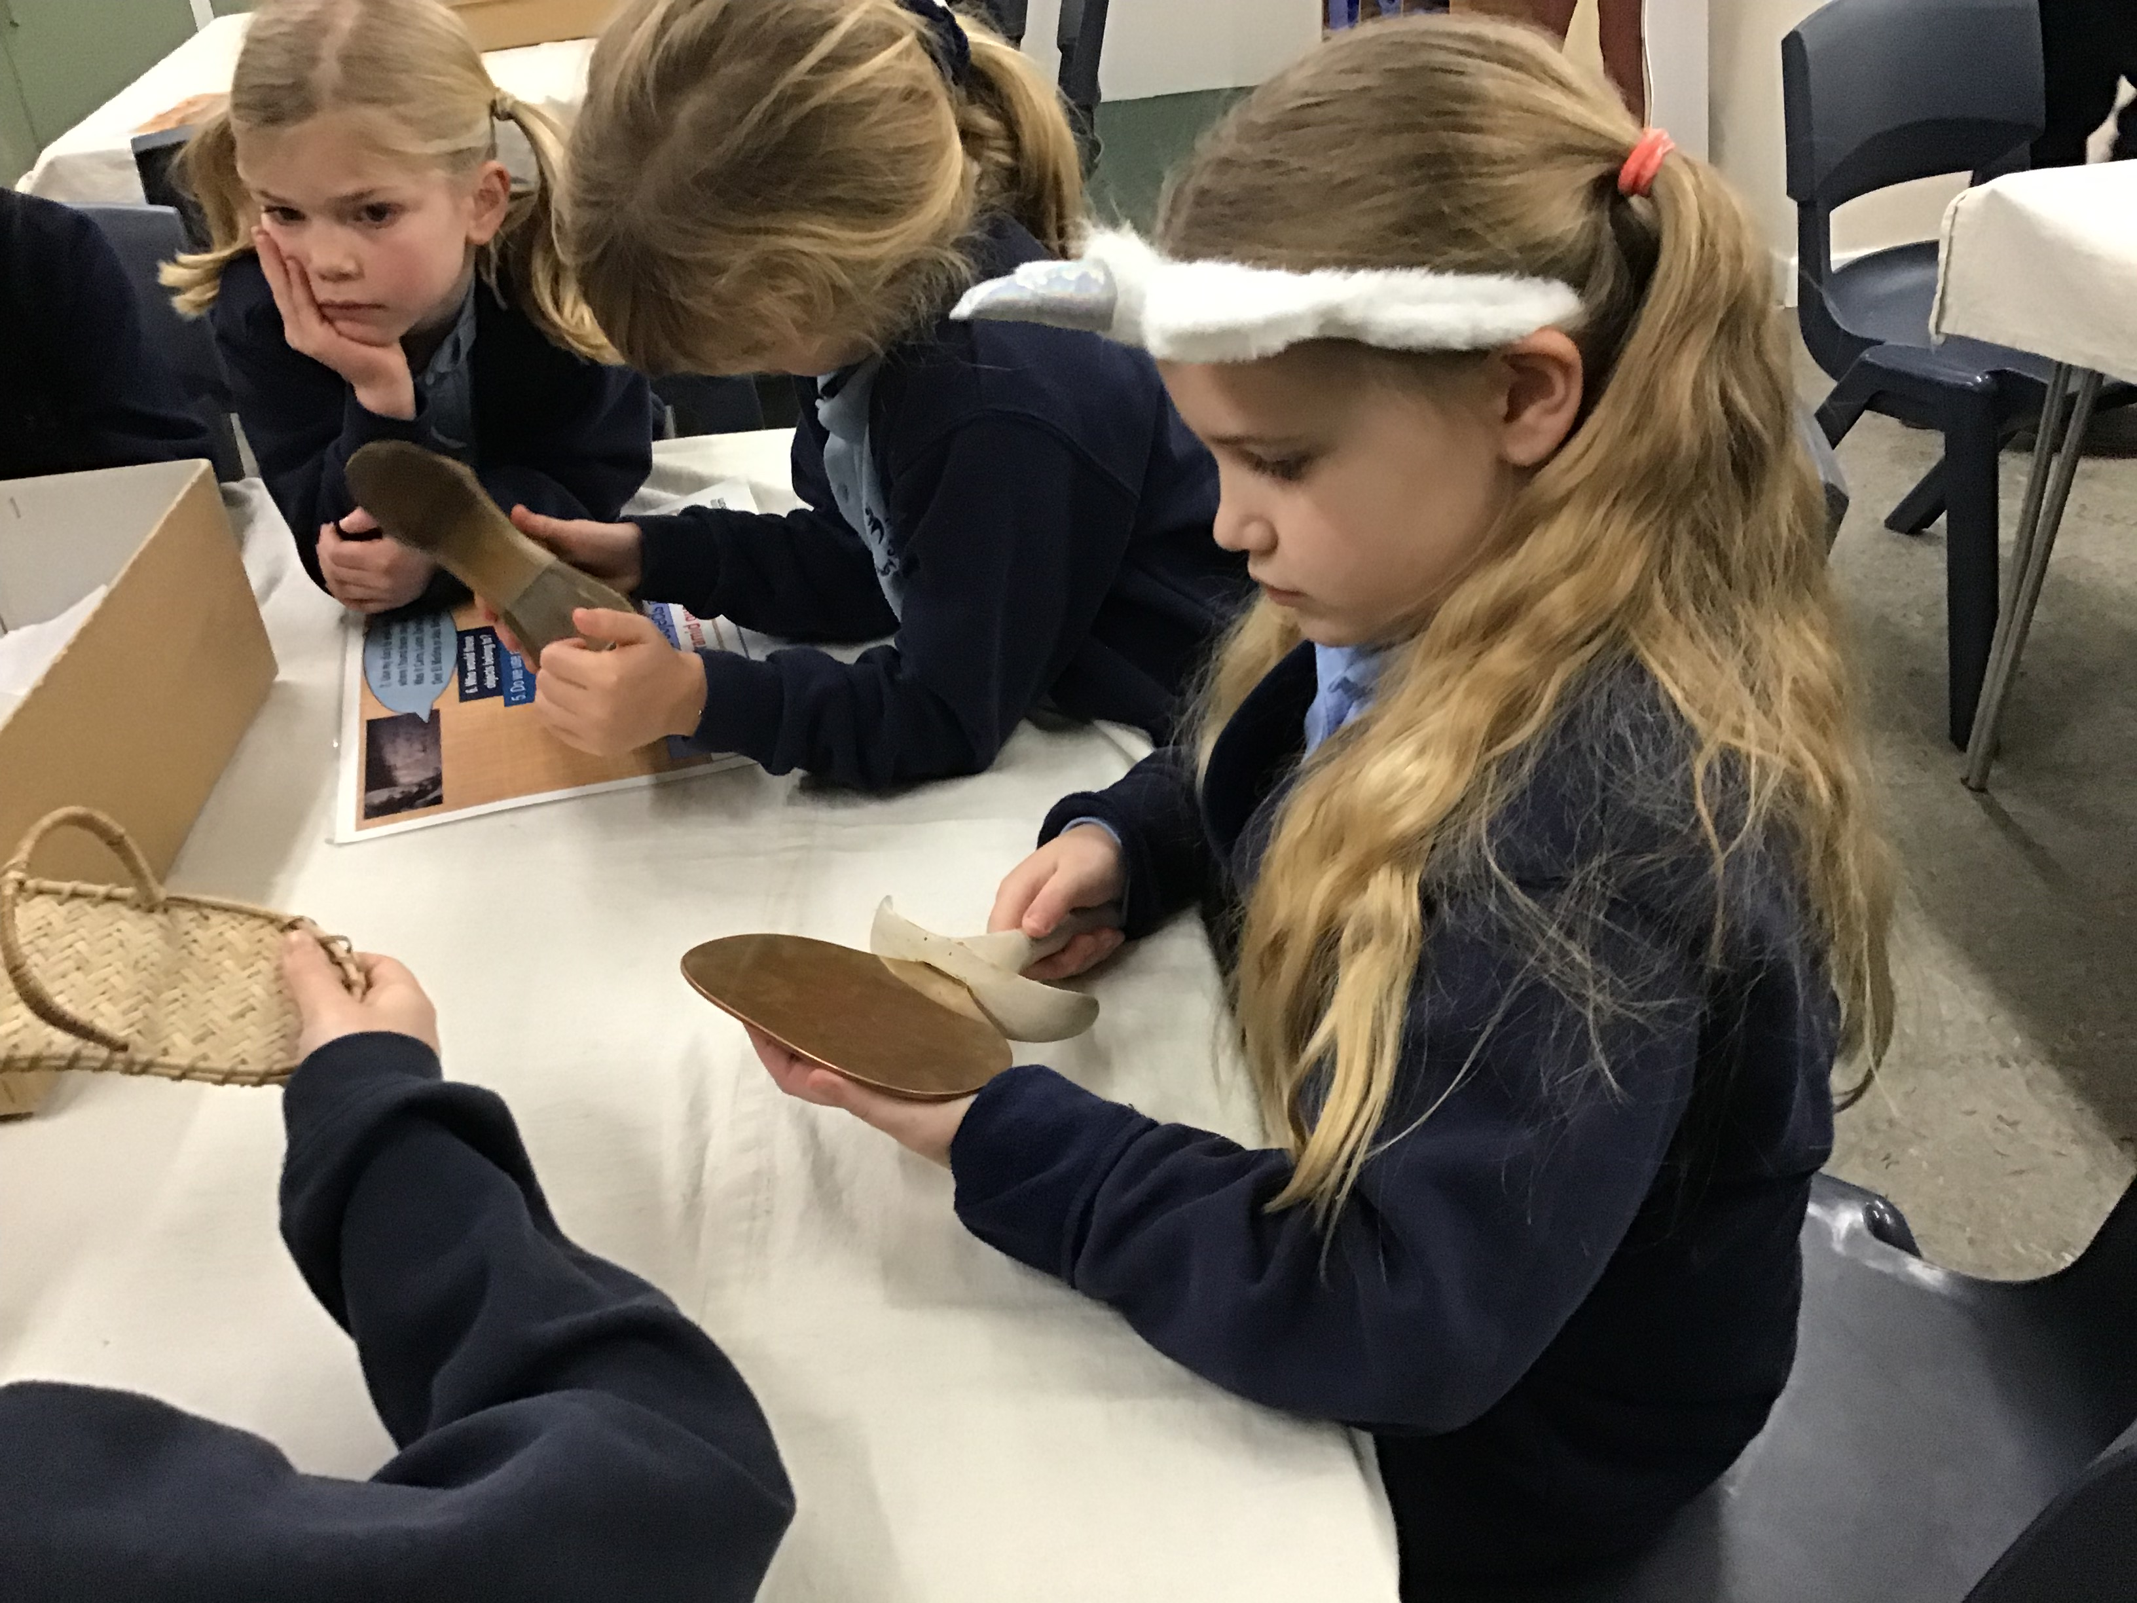
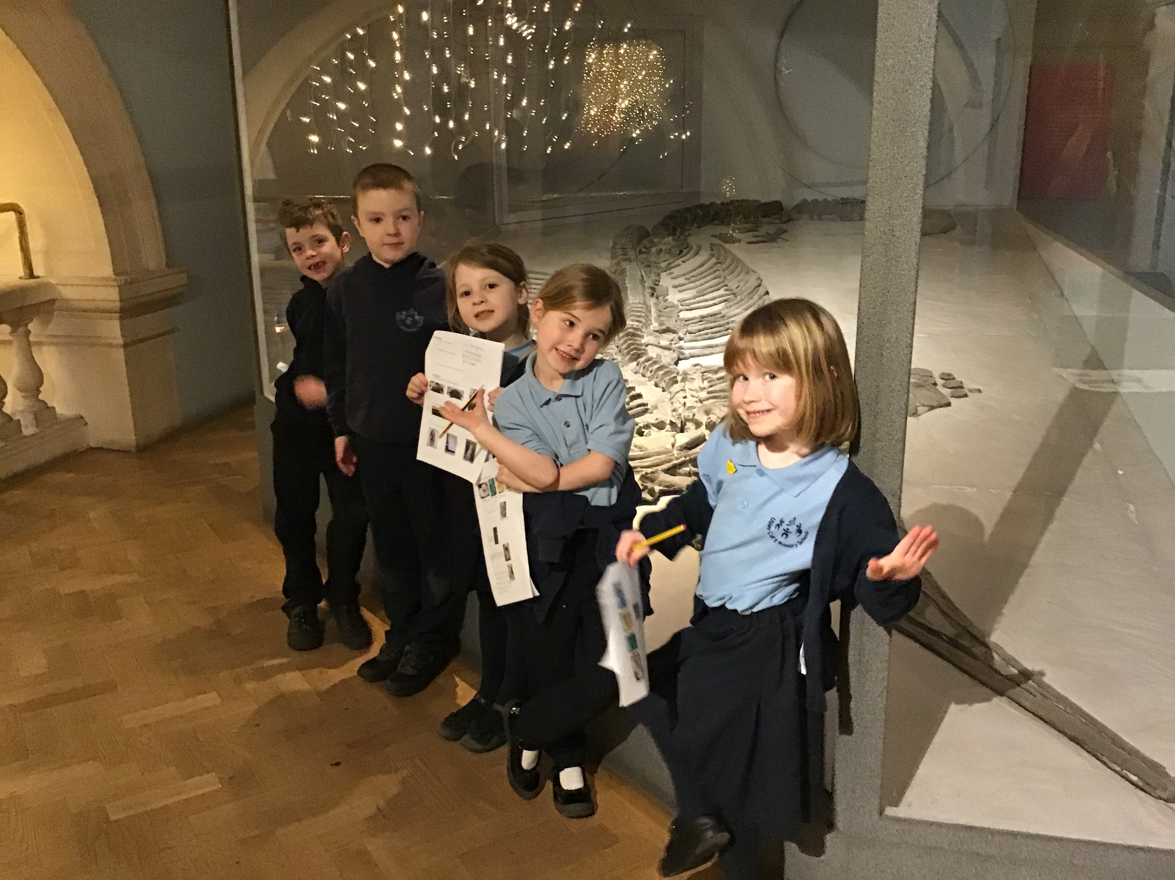
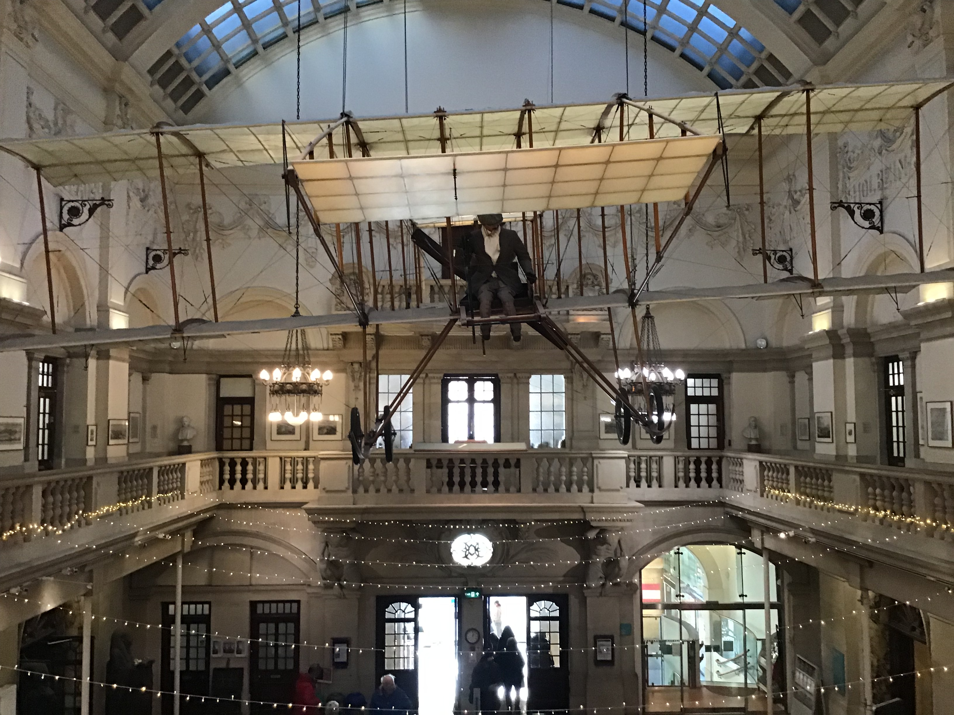
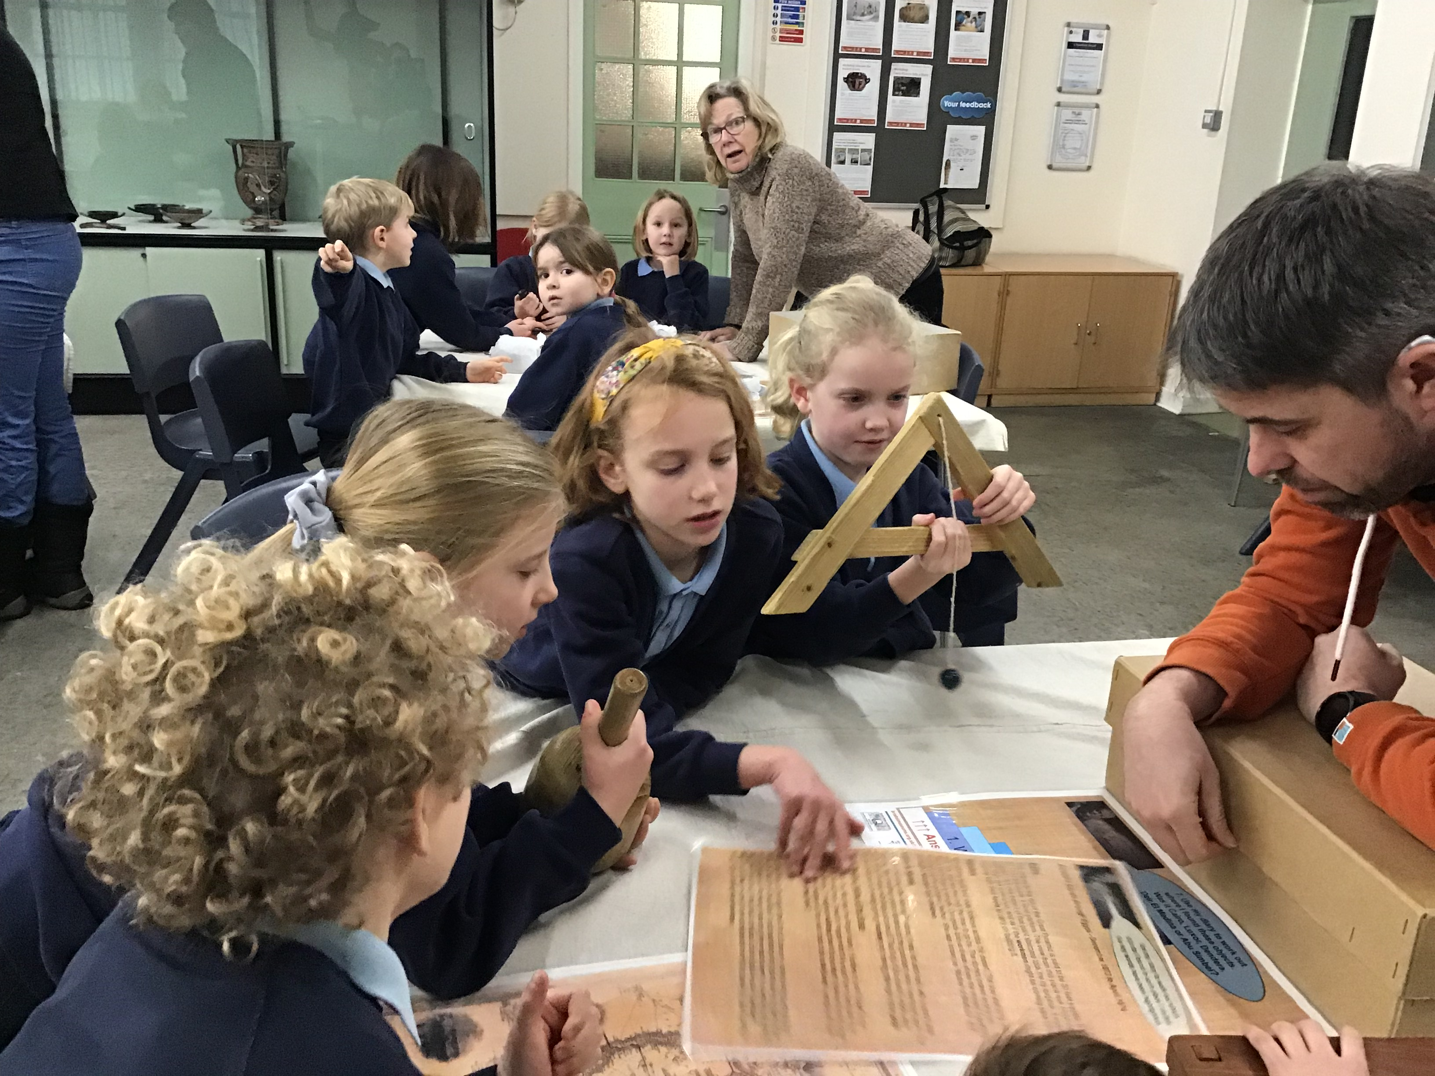
Squirrel trip to Bristol Museum ​​​
We had a great time at the ‘Bristol Museum and Art Gallery’ this week. Many thanks to Matt Smart, Lynda English and Tain Watson for all your support during the day, also to the PTA for making it possible by paying for the coach!​
​
Here are some comments from the children.​
​
I saw diamonds and artefacts from Ancient Egypt.​
Emily​
​
On Tuesday we went on a school trip to ‘The Bristol Museum and Art Gallery. My favourite part was looking at and holding the Egyptian artefacts in the workshop. I saw diamonds and stuffed animals.​
Beatrice​
​
On Tuesday we went to ‘The Bristol Museum and Art Gallery. When we got to the museum it looked tiny but when we went inside it was massive! We took part in a work shop and we got to handle artefacts telling us about the life of the ‘Ancient Egyptians’. We also learnt about Amelia Edwards. It was fun!​
Millie​

Slide 4
*Urgent request - Newspapers needed*
In Squirrel class this term we are making Egyptian masks. We will be using 'Papier Mache' to create them. If you or anyone you know reads newspapers please could you rescue them from the recycling box and bring them into school.
Many thanks,
Mrs Beck
Safeguarding Children
If any parent or carer is concerned about a child’s welfare or wellbeing please contact Mr Harvey or Mrs Brown, who are the school’s Designated Safeguarding Leaders.
Absent from school
Please ensure that you contact the school office if you need to let us know your child is unwell and won’t be attending school, if they have a sickness bug then they must stay off school for 48 hours after they were last sick.
Home Time changes
Please let school know if you are changing your home time arrangement, if you child is going home with a friend or being collected by somebody different.
Please do not send messages via class dojo as these messages may not be picked up during the day.
Thank you
office@ubley.school
Telephone 01761 462654
Diary Dates
24th February – Years 5 & 6 to Lifeskills
13th – 17th February – half term
20th February first day back
1st March years 3 & 4 to CVS for netball tournament, packed lunch needed
19th April – Years 3, 4, 5 & 6 to Field to Fork
23rd June – Class photographs
4th July – Year 6 transition day for Chew Valley School
Requests for leave of absence during term time
A reminder that the LSP Attendance Policy states that absences should only be granted in exceptional circumstances and a family holiday does not constitute such an exception. Our Trust policy is in line with the May 2022 statutory guidance to schools. In almost all cases a request for a holiday in term time will have to be refused and if the unauthorised holiday is for 10 or more sessions (i.e. 5 or more full days) it will incur a Penalty Notice.
Please follow this link for the attendance policy
https://www.eastharptreeandubley.org.uk/_site/data/files/35A50BD4930F9634BF552753A3C15692.pdf

